Slide 1
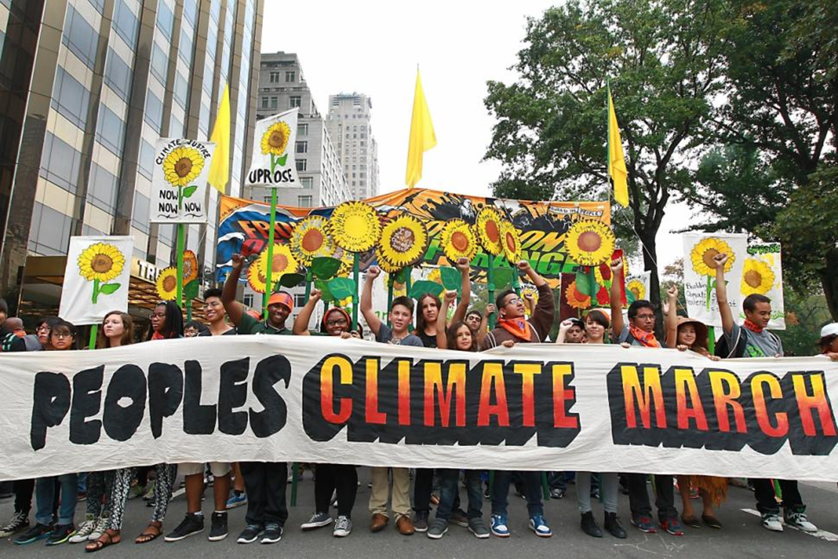
Background and Purpose
Communicating Climate Change
in South Korean News Media
Yeowon Kim
Arizona State University, Tempe, AZ, USA
The 2014 UN Climate Summit was held at the United Nations headquarters in New York on 23 September 2014 in order to engage leaders and to advance climate actions.
The President of South Korea, Park Geun-hye, called for a change in people's perceptions toward climate change during her keynote speech at the summit. President Park’s speech spurred high public attention on climate change issues in South Korea through various news media.
The relation between media coverage and public awareness of climate change is broadly recognized, and news media’s role in connecting expert discourse to public risk perception has become significant with the rising risk of climate change.
Hypothesis
Methodology
This work studies the ways climate change issues are framed by news media that have different political stances. In particular, this study examines how news media use two contrasting frames in social science: Prognosis: Solution oriented
vs. Diagnosis: Problem oriented
Prognostic framing focuses on finding solutions to climate change related problems (solution oriented). Diagnostic framing focuses on the magnitude of these problems and their impact on society (problem oriented).
Hypothesis: Conservative media will use prognostic framing for climate change news while liberal media will use diagnostic framing.
A case study of media coverage and news framing in two representative South Korean daily newspaper articles
: The Chosun Ilbo (conservative) vs. The Hankyoreh (liberal)
Target event for analysis: 2014 UN Climate Summit
Search keyword(s): “Climate change”
Search period: One week (22 September 2014 – 28 September 2014)
Data Collection
Data Coding
Comparative Analysis
Framing Themes and Affective Tone Codebook
Result
Framing themes
Prognosis |  | Diagnosis
Scientific uncertainty |  | Green life
Catastrophe |  | Green project
Economic implication |  | Green economy
Environmental Surveillance |  | Environmental nationalism
 |  | Political influence
Affective tone
Positive | Negative |  | Neutral
Positive influence or impact of climate change and/or its adaptation strategy | Negative influence or impact of climate change and/or its adaptation strategy |  | None or Both
The results show that the conservative newspaper’s themes are prognostic. Coping at a group or an individual level (i.e., green project, green life, and political influence, respectively) is covered most frequently.
The liberal newspaper does not show any preference for particular framing. The most frequent theme in the liberal newspaper is environmental surveillance, which belongs to the diagnosis frame.
There is no difference in the use of positive or negative tone in both newspapers. However, the results indicate that the positive tone of Chosun Ilbo's articles is most salient in its news stories with green project and political influence themes. This is also observed in Hankyoreh's news.
Discussion
This study demonstrates that political stance and framing are related when reporting climate change related issues in South Korea.
The media build particular images of scientific knowledge and uncertainty on climate change, and emphasize or de-emphasize forecasts of impacts, in order to sustain their political preferences. This link may affect public perception about climate policies and risks.
The most common framing approaches are prognostic and neutral, suggesting a dearth of solution oriented news in South Korea.
A secondary finding is that South Korean newspapers emphasize the national and political prestige of participation in the intergovernmental event rather than report the issues discussed during the event.
References
Boykoff, M. T., & Roberts, J. T. (2007). Human Development Report 2007/2008 Media Coverage of Climate Change: Current Trends, Strengths, Weaknesses Media coverage of climate change: current trends, strengths, weaknesses.
Carvalho, A., & Burgess, J. (2005). Cultural circuits of climate change in U.K. broadsheet newspapers, 1985-2003. Risk Analysis: An Official Publication of the Society for Risk Analysis, 25(6), 1457-1469.
Nisbet, M. C. (2009). Communicating climate change: Why frames matter for public engagement. Environment: Science and Policy for Sustainable Development, 51(2), 12-23
Institute for Social Science Research Poster Contest 2016
Yeowon Kim
Email: yeowon.kim@asu.edu

