Slide 1
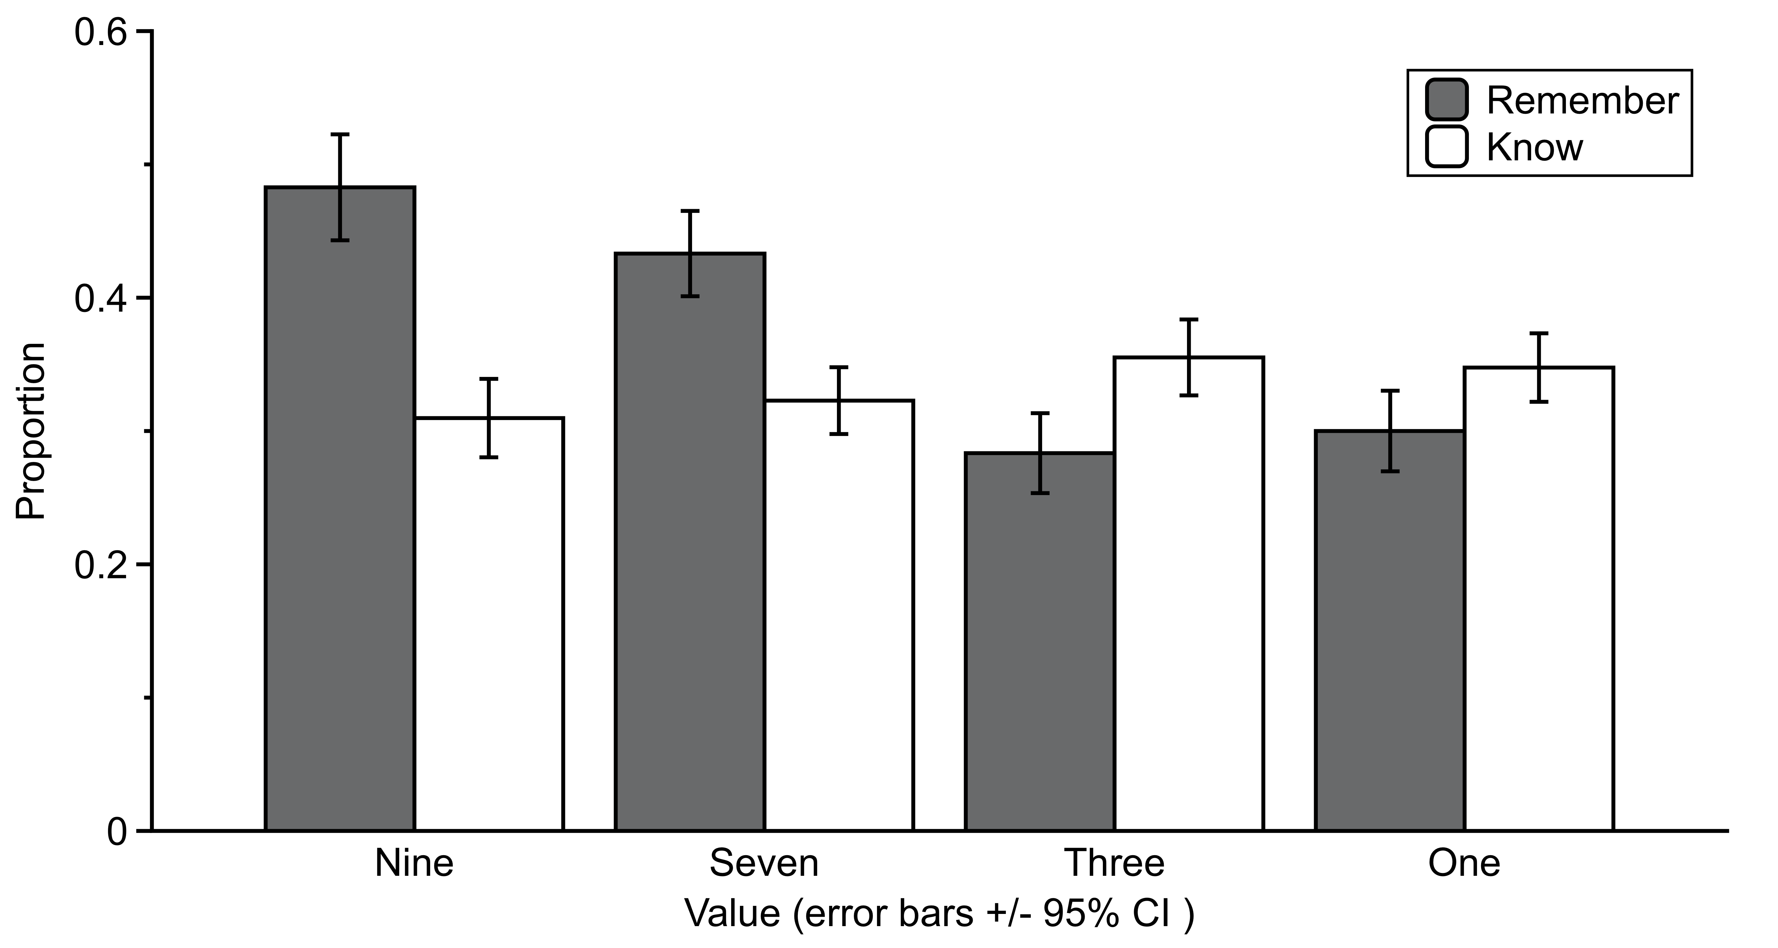
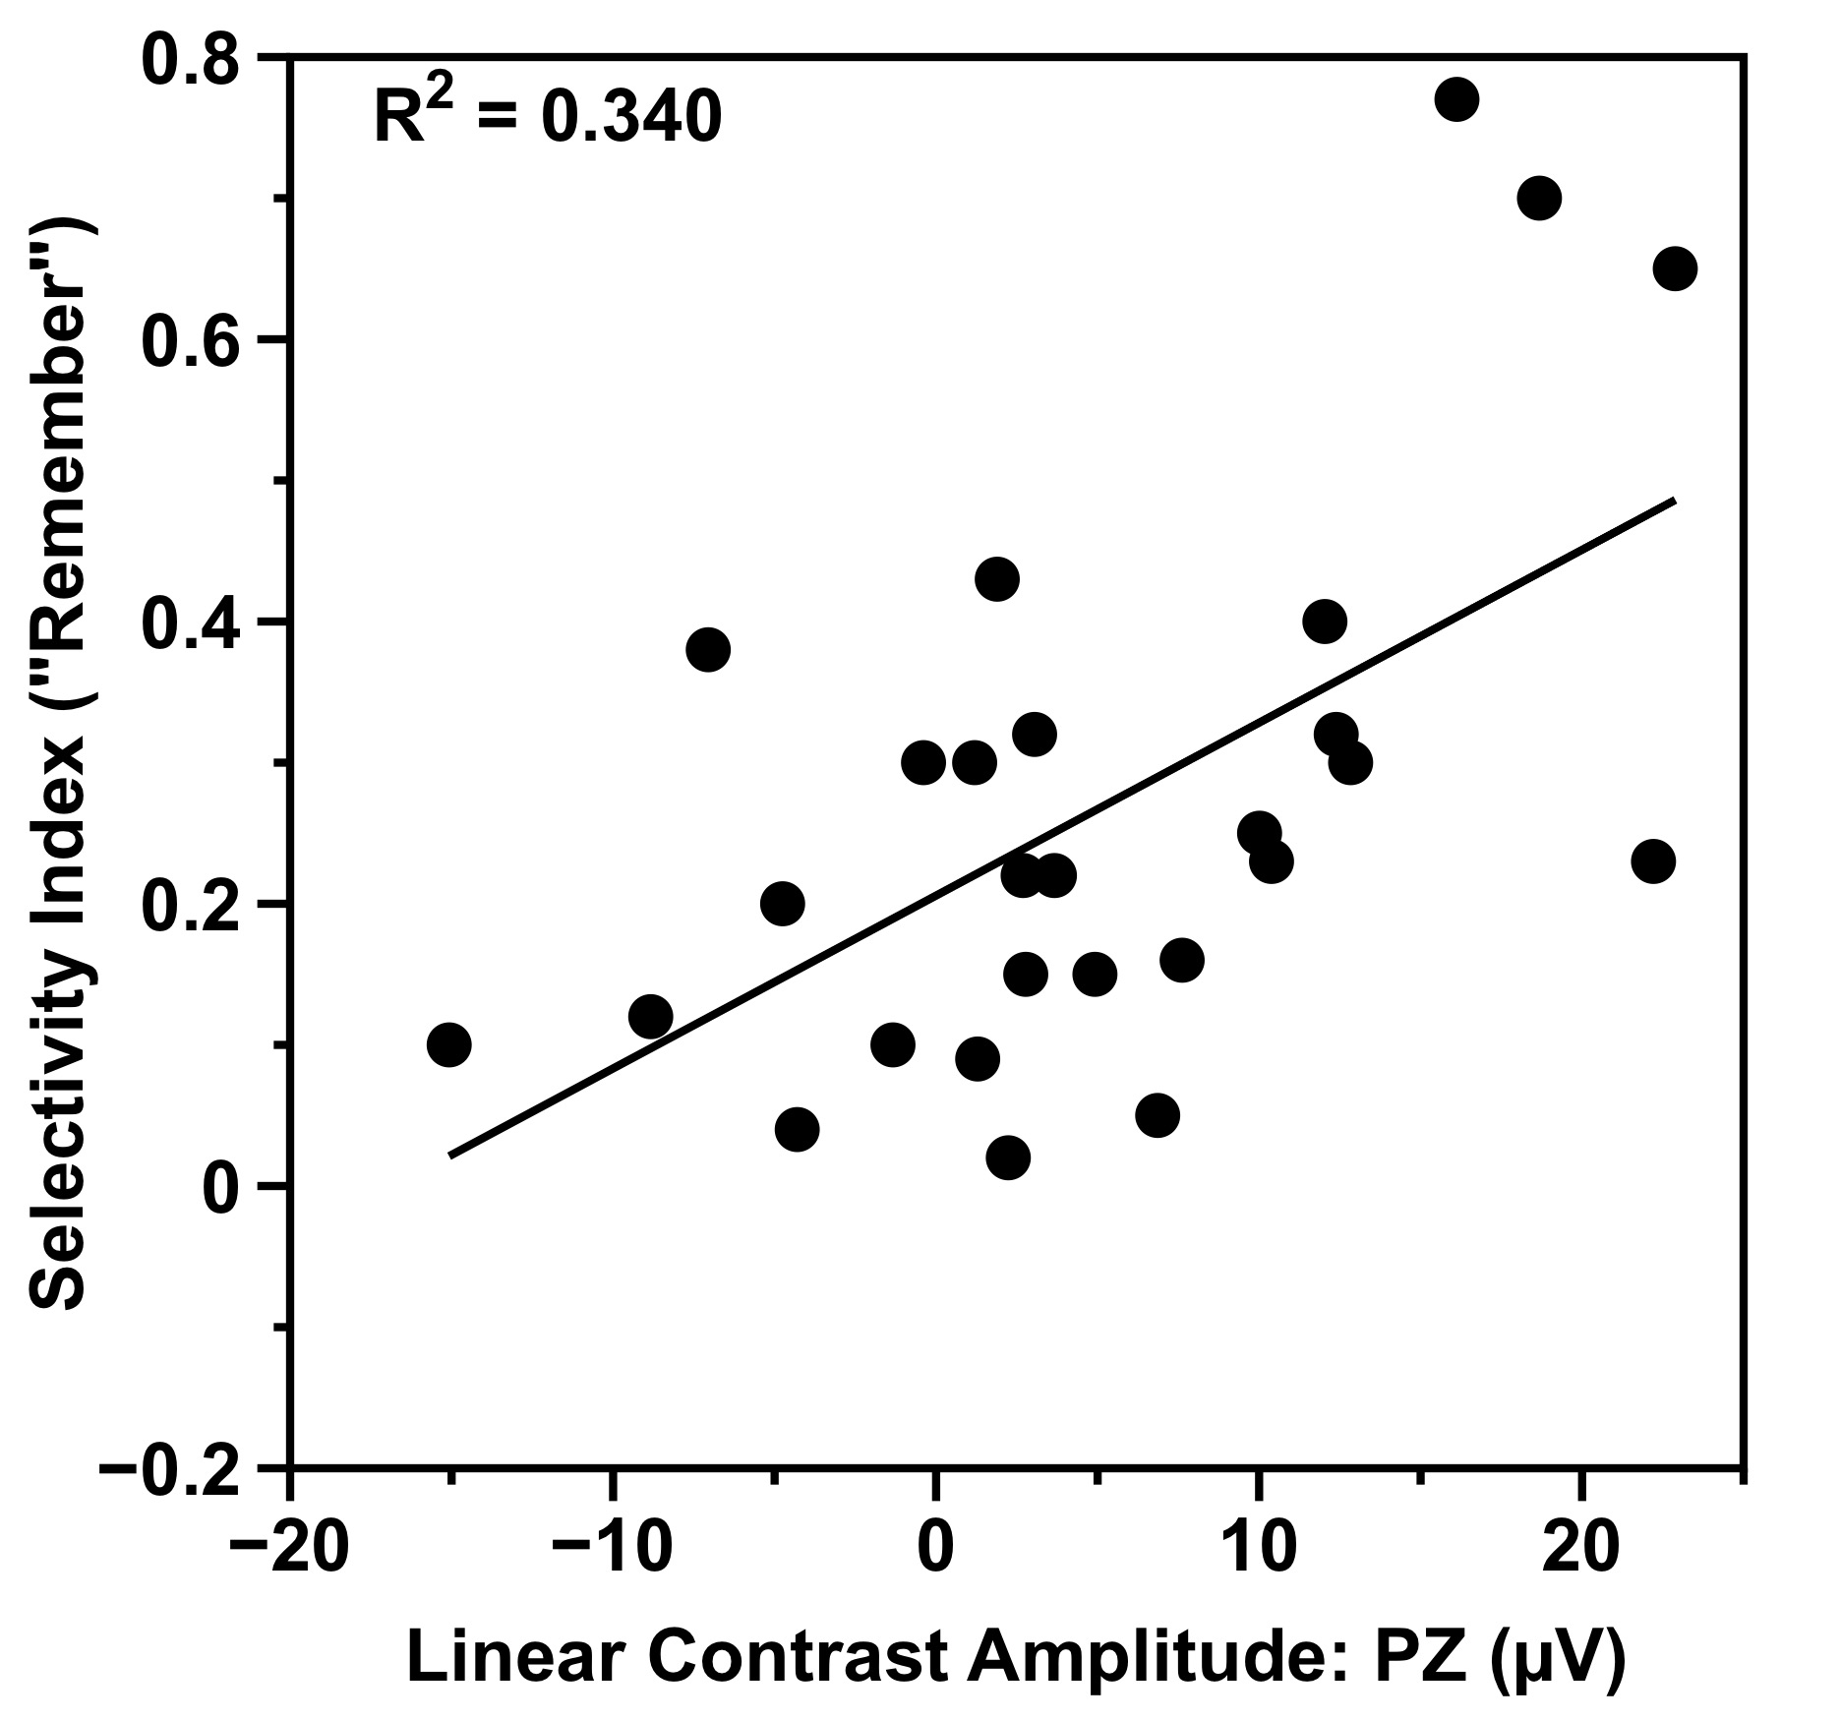
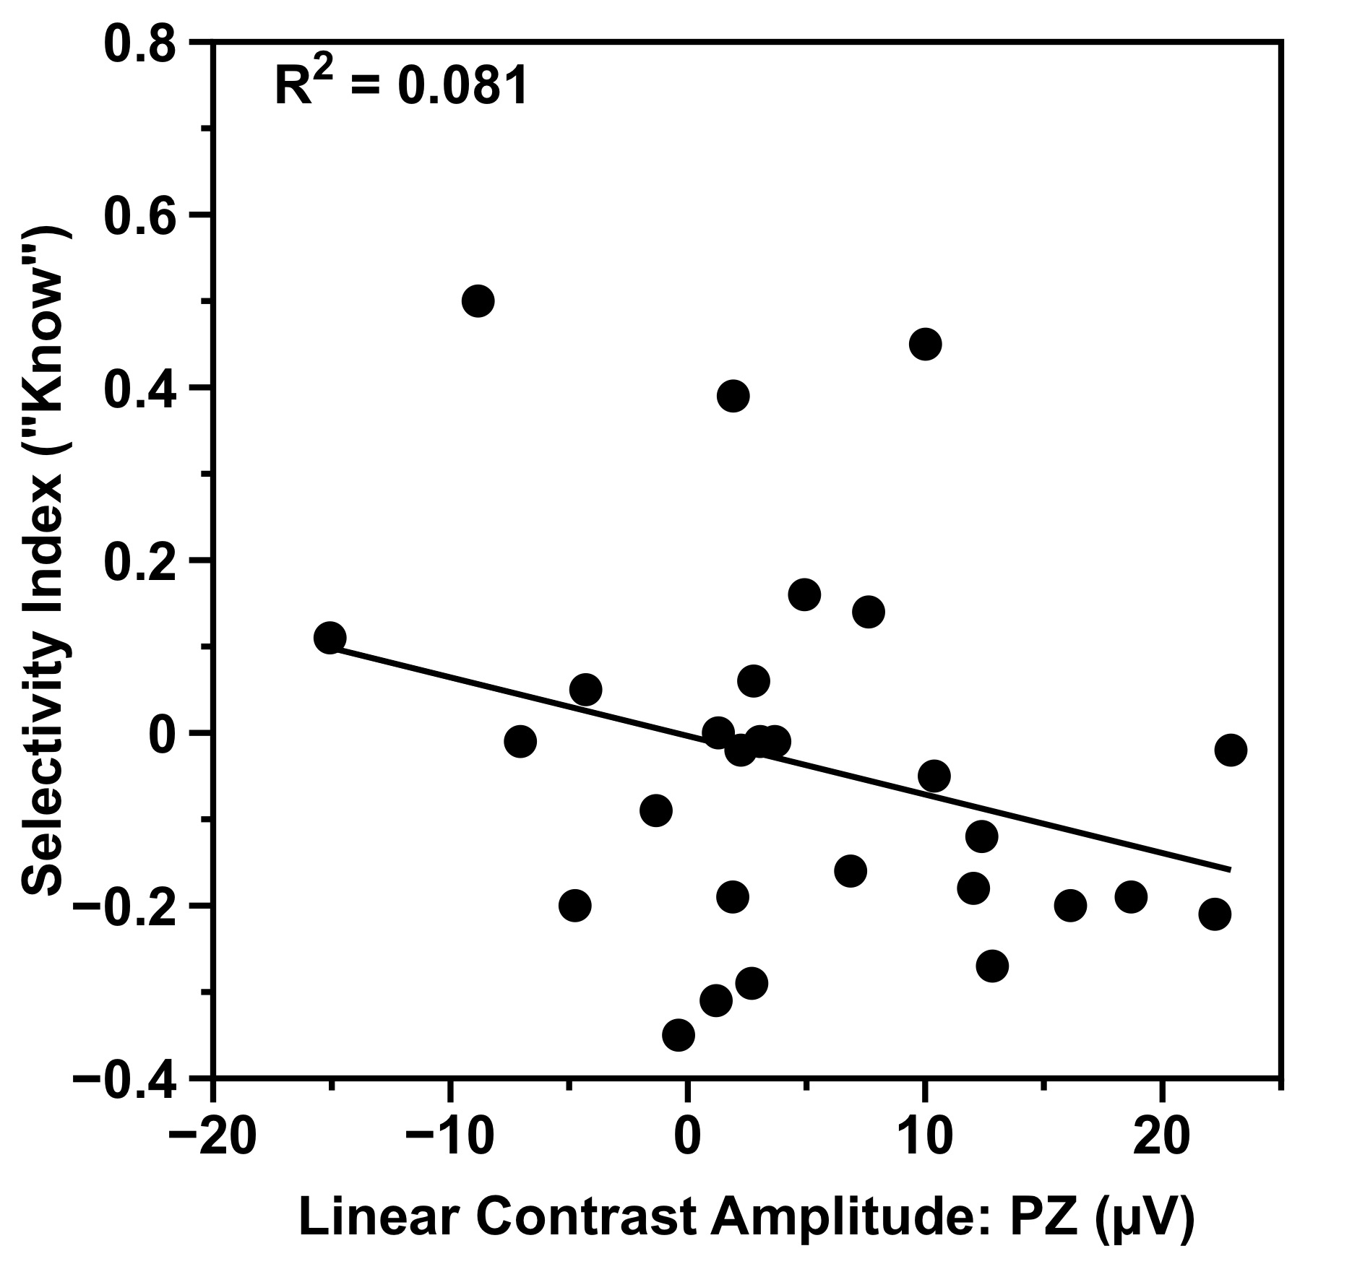
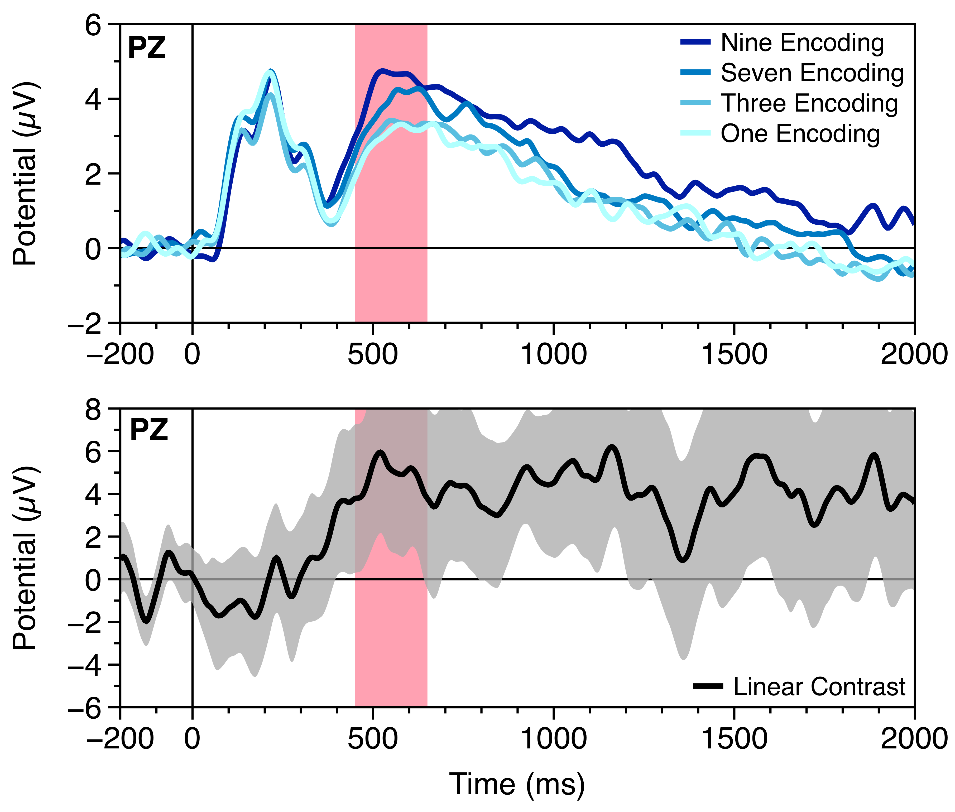
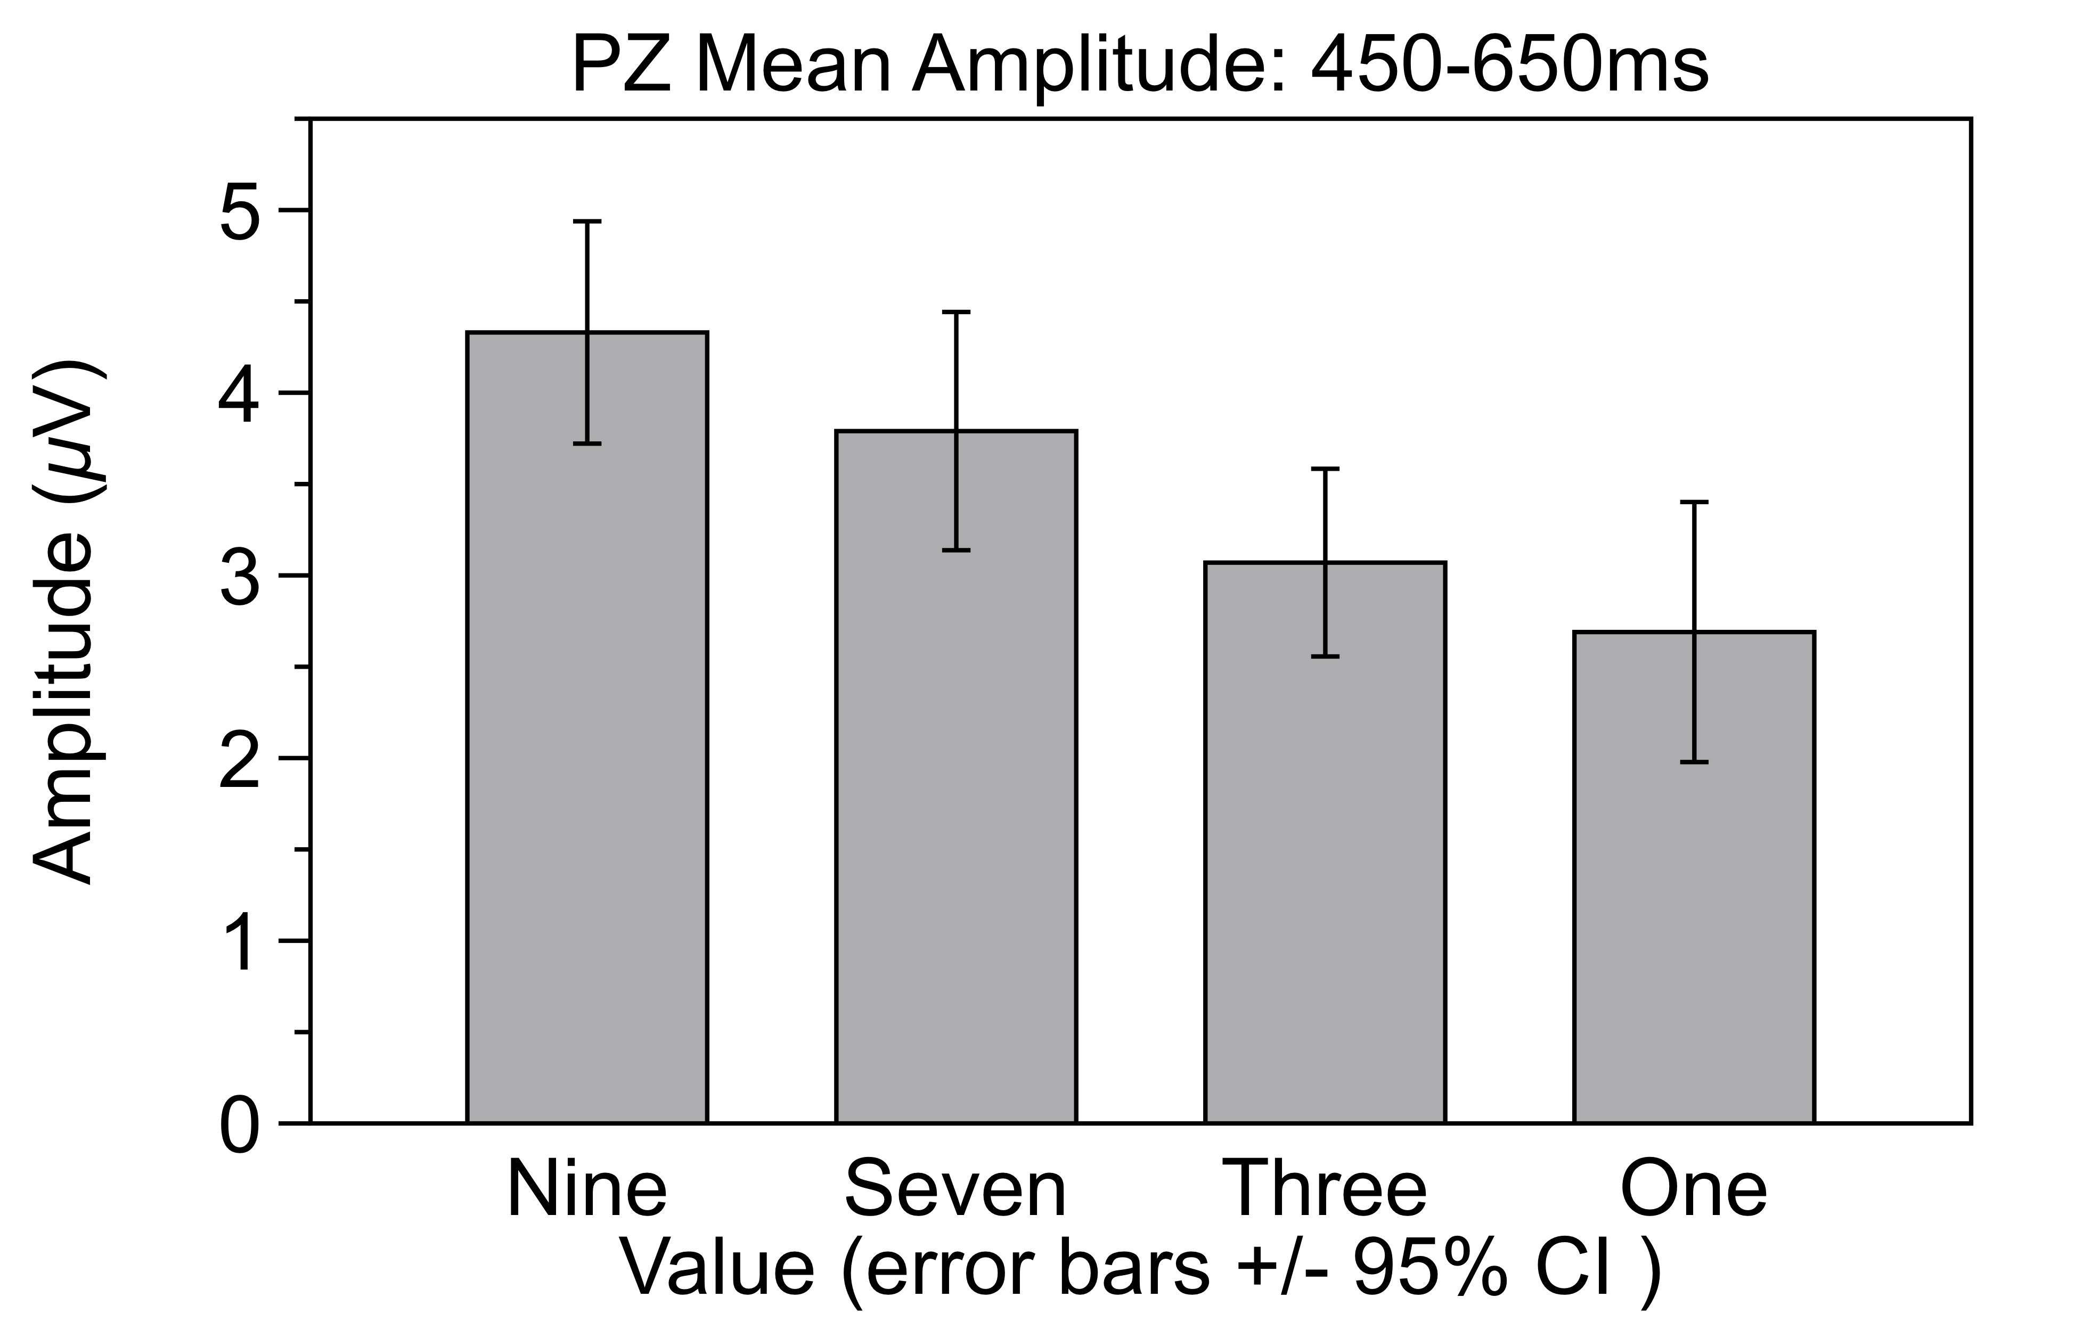
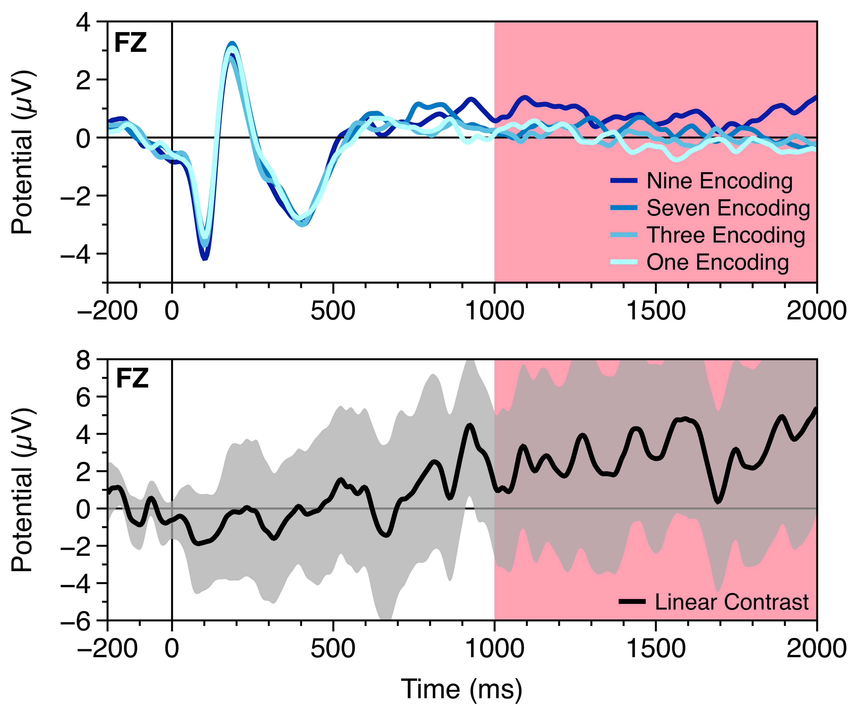
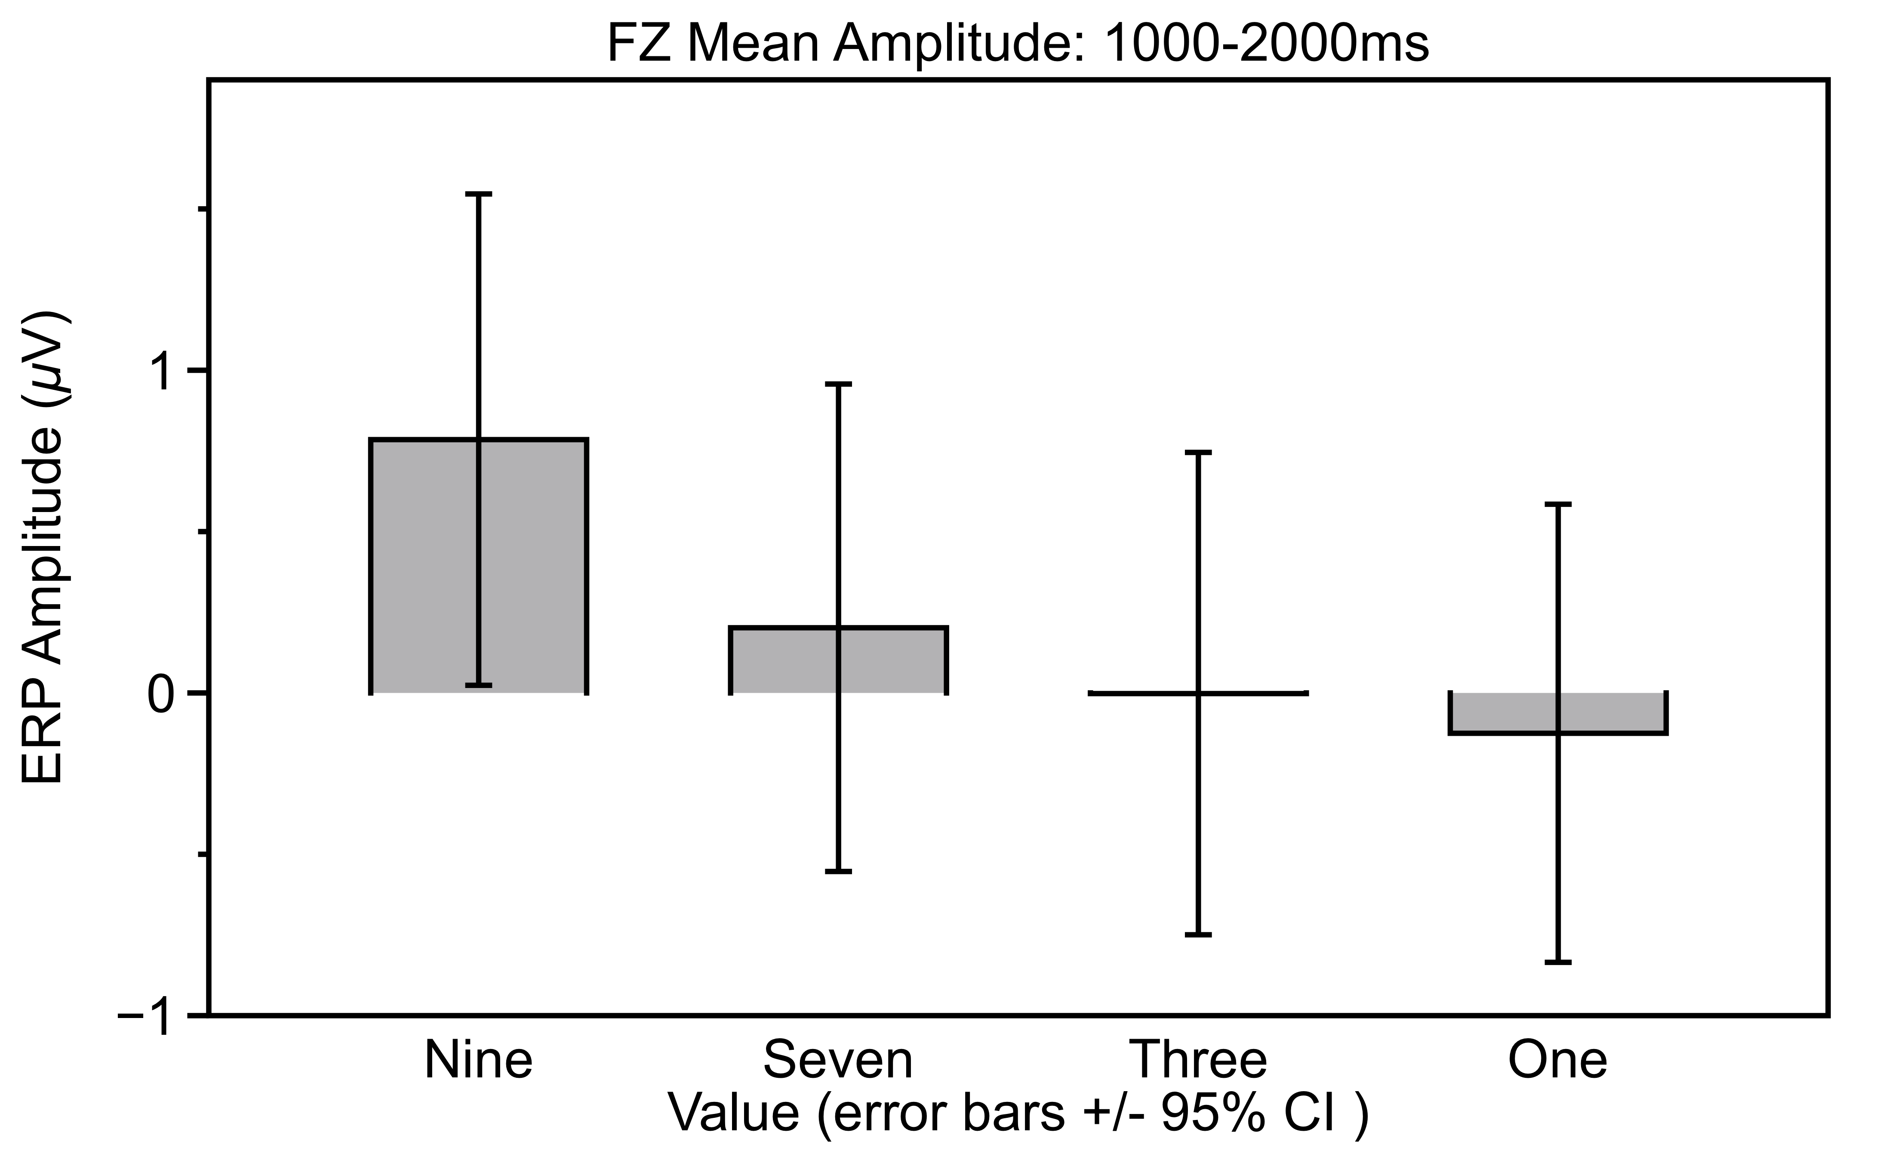
Neural Correlates Underlying The Effect of Value on Memory Encoding
nice, and cheaper than mine (by 30 cents), check out the abstract for what Mike Cohen is presenting, interesting shit
MACLab
The Memory & Attention Control Laboratory
Blake L. Elliott, Chris Blais, Gene A. Brewer
Arizona State University
Introduction
Behavioral Results
Sensitivity To Value
The ability to selectively encode important or valuable information is essential to human memory
This is tested using reward learning and value-directed memory paradigms
These paradigms typically assign values or monetary rewards to stimuli and participants try to remember higher value stimuli to maximize their score² (e.g. CAR 3…. HOUSE 9)
Higher Valued stimuli are bettered remembered than lower valued stimuli¹
Recognition Memory
The ability to recognize previously encountered words, objects, people, etc.
Typical paradigm consists of a study (encoding) phase and a test (retrieval) phase
Two processes contribute to memory strength during test²
►Familiarity (“Knowing” something is old): Weaker memory with no episodic details
►Recollection (“Remembering” something is old): Stronger memory with episodic details
The current study examines which recognition memory processes are affected by value-directed encoding and whether differences EEG activity during the study phase can differentiate encoding processes utilized
How well a participant maximized their score can be measured using the Selectivity Index
Ranges from -1 (minimum possible score for number of words recognized) to 1 (maximum possible score for number of words recognized
Calculated separately for words given “Remember” responses and words given “Know” responses
The effect of value on on the P300 ERP component (measured by linear contrast amplitude) correlates to how sensitivity to value
This correlation is only seen for deeper “Remember” responses
Higher-valued remembered better than lower valued words (significant linear trend)
This effect was only shown in ”Remember” responses and not for ”Know” responses
Value affects only deeper episodic memory (recollection)
Selectivity Index =
subject’s score - chance score
ideal score - chance score
P300
EEG Encoding Results
Scalp Topography
*
Two ERP components associated with better recognition memory performance, but different encoding strategies
P300: 450-650ms post-stimulus over parietal electrodes (PZ)
Greater amplitude associated with increased attention and dopaminergic reward processing
Frontal Slow Wave (FSW): 1000-2000ms post-stimulus over frontal electrodes (FZ)
Greater amplitude associated with more elaborative rehearsal strategies
Linear Contrast Amplitude: 450-650ms
Methods
Value-based recognition memory task, 30 participants
Study phase: 40 nouns from the Toronto noun pool randomly assigned either a value (9,7,3, or 1), presented randomly
Test phase: 80 words, including all 40 from the study phase, self paced responses of either New, “Know”, or “Remember”
Study and test phase 1 block, 5 blocks completed
EEG recorded during study phase
ERP
Scalp Topography
Conclusion
Nine
Seven
Three
One
P300
Behaviorally, higher-valued words were remembered better, this effect was localized to the recollection process. This indicates higher-valued words create deeper, more episodic memories
The FSW showed no effect of value, indicating that value did not lead to increased elaborative rehearsal
The P300 component demonstrated an effect of value, indicating that value affected earlier attentional components (possibly dopamine driven)
The effect of value on the P300 component correlated to how sensitive participants were to value with their responses, providing evidence that P300 component indexes value selectivity
CAT
Study
Test
9
+
CAR
CAT
CAR
ERP
Scalp Topography
2s
+
+
Nine
Seven
Three
One
.3-.5s
7
+
BRICK
.3-.5s
DOG
References
+
+
FSW
3
+
CAT
CAT
1.Castel, A. D., Benjamin, A. S., Craik, F. I. M., & Watkins, M. J. (2002). Aging and selectively in memory. Memory & Cognition, 30(7), 1078-1085.
2. Watkins, M. J., & Bloom, L. C. (1999). Selectivity in memory. Unpublished manuscript
3. Yonelinas, A. P. (2002). The nature of recollection and familiarity: A review of 30 years of research. Journal of Memory and Language, 46(3), 441-517.
+
+
1
+
ANT
ANT
Time

