Slide 1
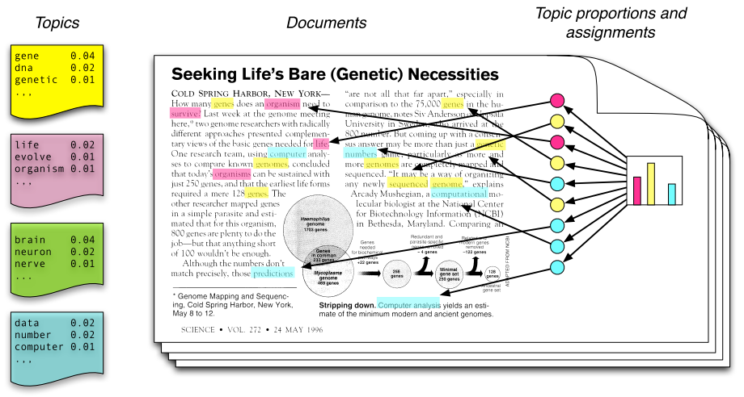
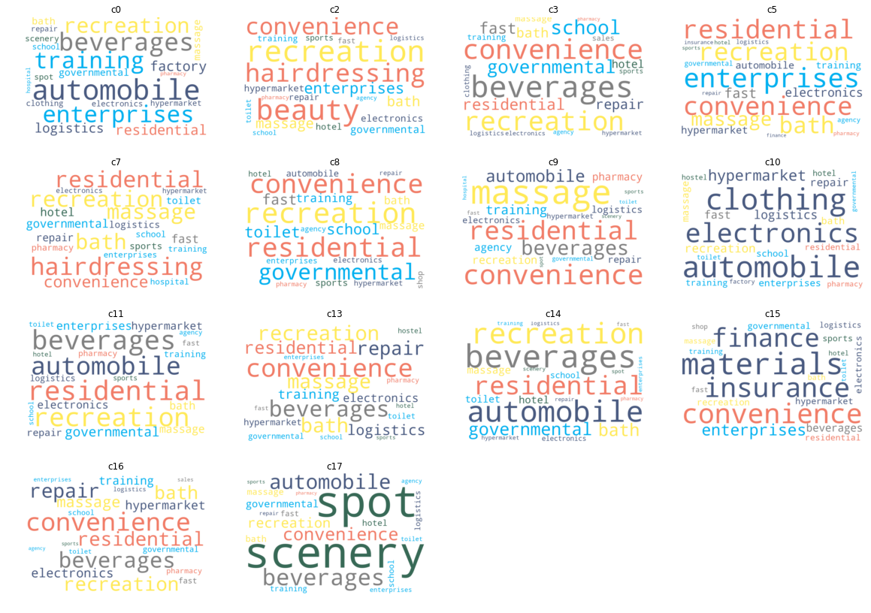
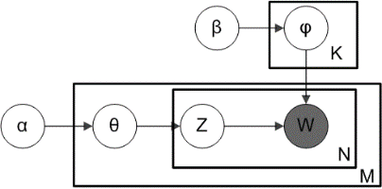
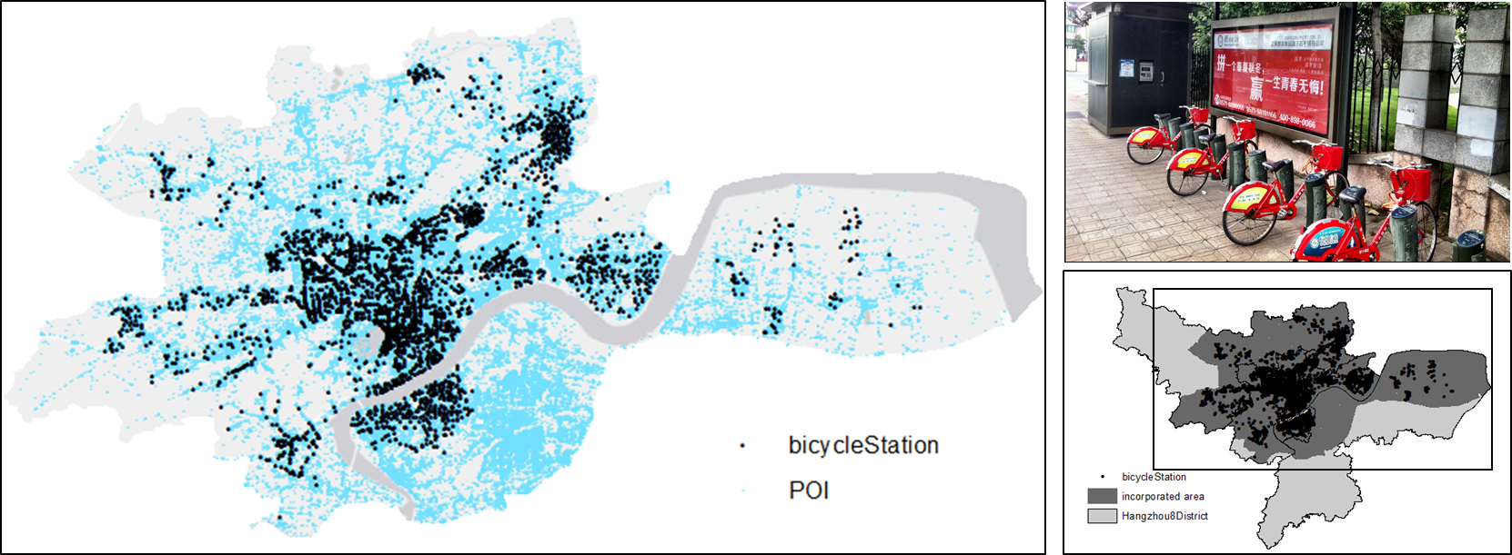
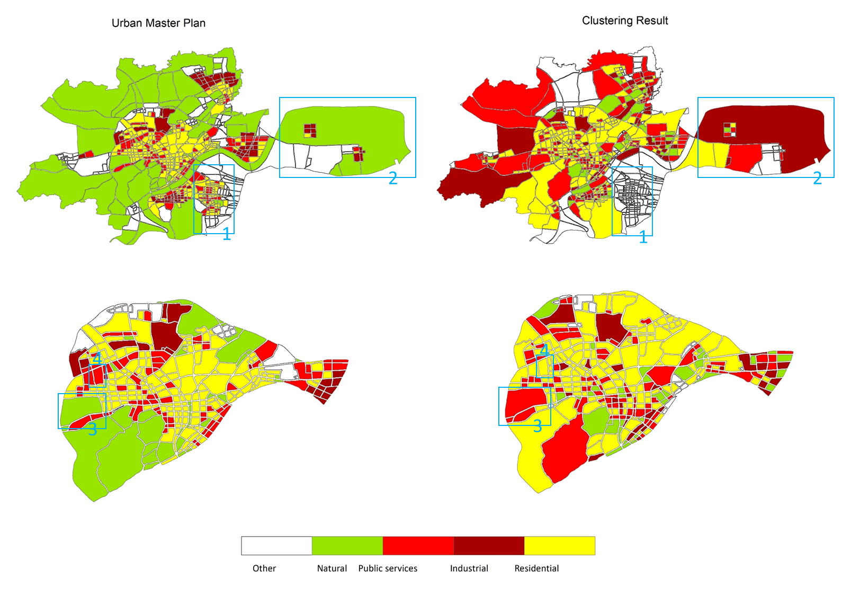
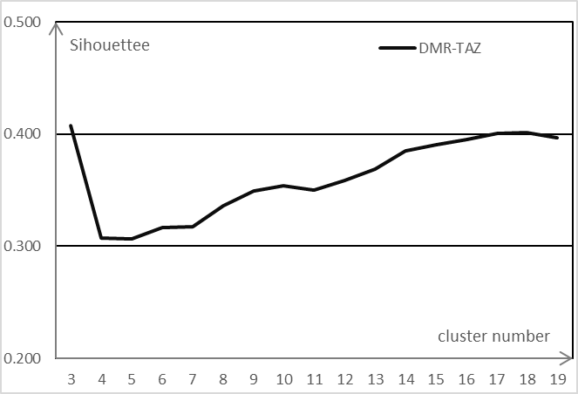
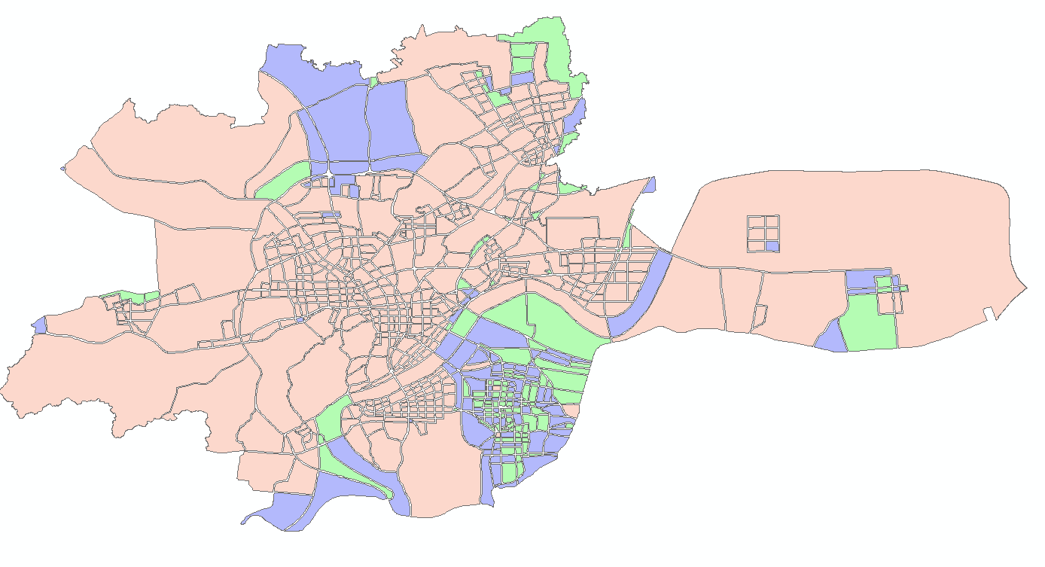
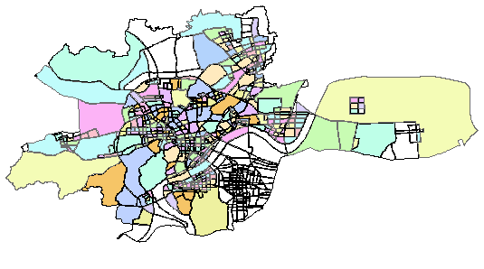
Analyzing Urban Land Use Using Bike Rental Records and POI Data
Xiaoyi Zhang^{1,2}, Wenwen Li¹ ¹School of Geographical Sciences & Urban Planning , Arizona State University, ² School of Earth Sciences, Zhejiang University
abstract
methods
results
Land-use classification is essential for urban planning. Urban land-use types can be differentiated either by their physical characteristics (such as reflectivity and texture) or social functions. Although significant progress has been achieved in remote sensing methods designed for urban land-use classification, most techniques focus on physical characteristics, whereas knowledge of social functions is not adequately used.
Recent studies use new sources of big data as a complementary way to indicate the social function of land use. These kind of big data includes mobile GPS data, taxi trajectories and social media such as Twitter, which have been demonstrated to bring about the opportunity to derive a finer intra-urban land use.
In our study, we try to explore and verify such probability using bicycle rental data. We use a ‘big’ dataset from the auto-bicycle sharing system (BSS) in Hangzhou, China, which has a ten-day continuous rental information per hour of 3,403 bicycle stations, to show how the dynamic bicycle demand and local POI information can be efficiently utilized in the detection and understanding of urban land use.
Topic modelling technique in urban land use identification
Land use labeling result
Validation
The DMR topic model is chosen because it takes meta information into the topic generative process and keeps an efficient and robust performance.
Accordingly, we define an analogy to detect urban land use:
Topic → Land use type
Word → Bicycle rental status
Document → Land use unit (TAZ)
Corpus → Study area (TAZs)
Author → POI vector
Figure 2. The topic modelling process and plate annotations of LDA (left) and DMR (right)
Step 1: functional matrix extraction
Land use unit
construct transportation analysis zone (TAZ) by delineating road space, which is generated by buffering operation of road network, from urban area.
Station characterization
calculate and sum up each hub stations’ rented / total ratio of a given hour, and thus the continuous word of different time compose of a document
Vector calculation
construct a meta vector$x =\left(v_{1}, v_{2}, …, v_{n} \right)$ where n is the number of POI category and $v_{i}$ is the frequency of the i-th POI category in a TAZ
orange: daily life
yellow: recreation and leisure activity.
blue: public services
dark blue: business and commercial activities
green: attractions and travel facilities
Introduction
Figure 4. Sematic annotation set of different clusters and stop-words dictionary
Public bicycle sharing system (BSS) in Hangzhou, China
initiated by the local government in 2008.
Serve for commuters and tourists
one-way trip, low cost, 24/7, third generation BSS
use smart card and kiosk to check-in and check-out
Data
Bicycle rental data. We sampled the rental records of all bicycle stations hourly from 2017-11-11 06:00 to 2017-11-21 05:00, with a number of rent bicycles and restored bicycles for each station.
POIs. We use a number of 292,885 point-of-interests (POI) from Gaode Map database. It has a basic information related to a specific coordination like address, name, and category.
City boundary and road network. We used the city boundary and road network data (only the primary, secondary and tertiary roads) extracted from Open Street Map’s Planet OSM project.
Step 2: region aggregation
According to our sematic annotation results, we got a large number of residential clusters (c0, c2, c5, c7, c9, c10 and c13) with a batch of daily life labels. And it impressed us by the high weighted Hangzhou-style (Leisure City) labels, like massage, bath and tea around these residential area. Other clusters combine residential function with specific function like industrial (c3, c11) or educational (c8) or business (c14, c16). And there are two more independent cluster, financial area (c15) and tourist spots (c17).
We employ K-means clustering method to implement the region aggregation process. Those regions that are similar in the topic space might contribute to the same urban function and can be aggregated into the same cluster as a functional region.
The silhouette criterion is the most widely used index for determining an appropriate value of cluster number. The range of silhouette value is between 0 and 1. A high value (close to 1) indicates that an object is appropriately clustered and is very dissimilar from other clusters.
Step 3: land use Labeling
transform POI category information within each TAZ into a vector space and remove special characters (like ‘/’ and ‘&’) and stop words.
calculate the term frequency (TF) and term frequency-inverse document frequency (TF-IDF) value of each category.
draw the word cloud using TF-IDF weight with a grouped color on different land use functions
Figure 1. The spatial distribution of bike stations and collection of POIs
result
Region aggregation result
we tried different K values ranging from 3 to 19 and calculated the silhouette value in Figure 3. The silhouette value first gets a high score when cluster number is three, then sharply goes down and gradually increases when cluster number gets larger, and finally it goes down again after the number of 18. So we chose 3 and 18 to be candidate cluster numbers as they have the maximum silhouette value.
The inactive area (where there is few bicycle stations) remained in the clustering results both when k = 3 and k = 18. However, the diverse clusters in intra-city area when k = 18 showed that we captured the different characteristics within different functional area.
Figure 5. The validation results at two spatial levels
In addition to the unsynchronized datasets, four typical errors are marked in Figure 5 with blue squares：Missing data (1)，Scale issue (2)，Sematic difference (3) and Station characterization inefficiency (4).
reference
Conclusion
Mimno, D. and McCallum, A., 2012. Topic models conditioned on arbitrary features with dirichlet-multinomial regression. arXiv preprint arXiv:1206.3278.
Yuan, J., Zheng, Y. and Xie, X., 2012, August. Discovering regions of different functions in a city using human mobility and POIs. In Proceedings of the 18th ACM SIGKDD international conference on Knowledge discovery and data mining (pp. 186-194). ACM.
Liu, Y., Liu, X., Gao, S., Gong, L., Kang, C., Zhi, Y., Chi, G. and Shi, L., 2015. Social sensing: A new approach to understanding our socioeconomic environments. Annals of the Association of American Geographers, 105(3), pp.512-530.
The clustering result of city functional matrix has a pretty good consistency with the urban master plan, and is especially good at the detection of residential area and industrial area.
Our data-driven analyzing process works well in central urban area with a dense bicycle station distribution and a relatively finer land use unit.
Figure 3. The choice of different cluster number (k = 3 and k = 18)

