Slide 1

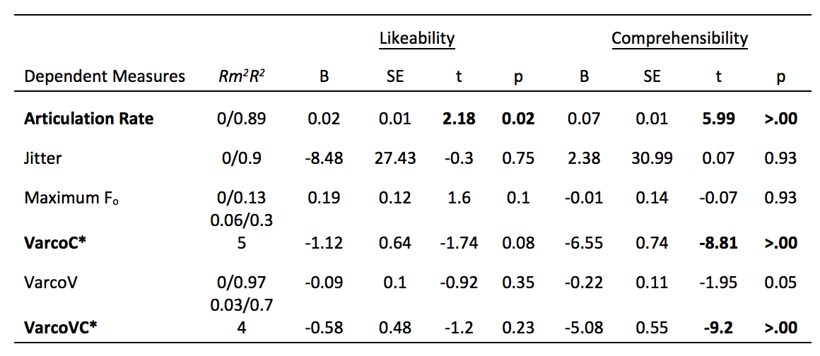

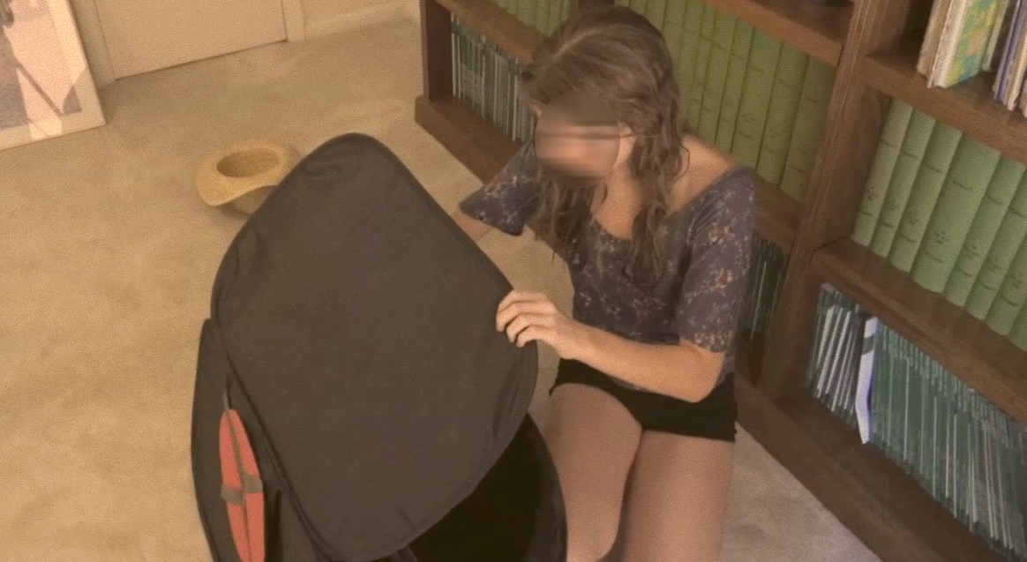
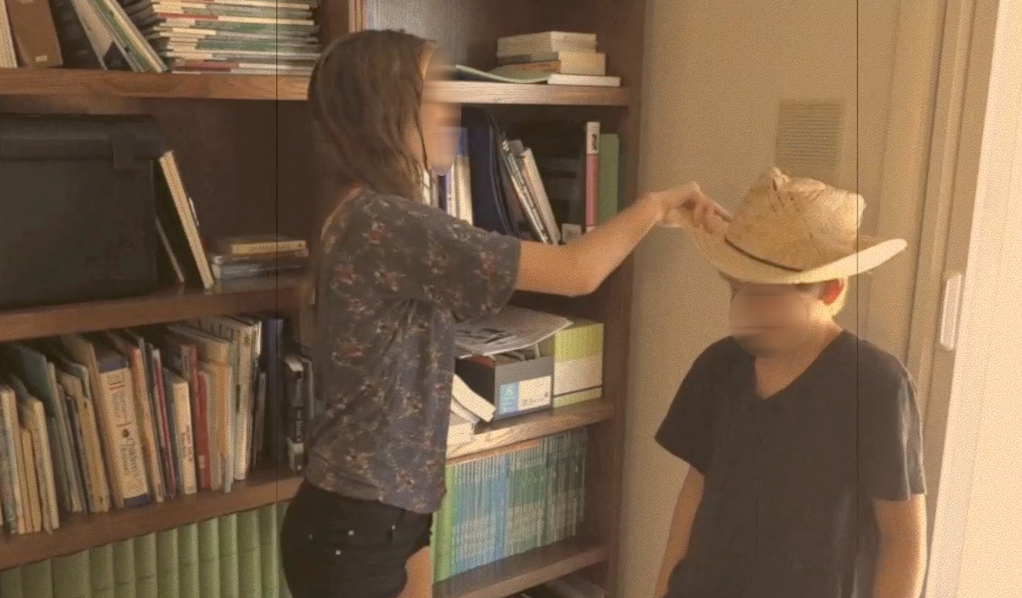
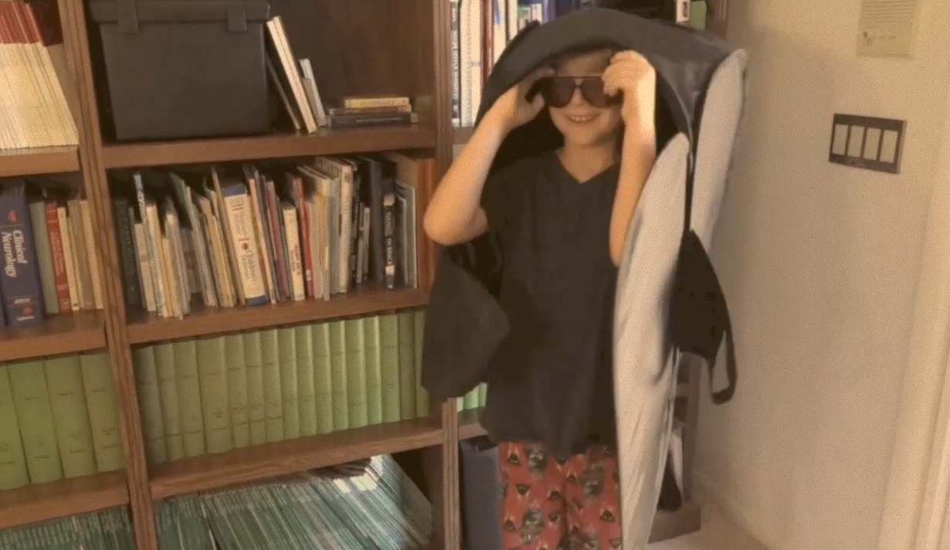
The Rhythm of Successful Communication
Jade Yonehiro, Xiaochen Sun, Stephanie Borrie, & Nick Duran
Background
Part 2 continued
Perception Measures
Communicative Rhythm
The variations of vocal acoustics during communicative speech.
How do variations in the rhythmic qualities of speech influence the perception of a speaker’s likeability and comprehensibility?
Listened to 20 of the story telling recordings
Rated story tellers
5 point Likert Scale
1 = Strongly Disagree; 5 = Strongly Agree
Comprehensibility
Likeability
Likeability
Comprehensibility
Question
Measures
I would like to be friends with this person
This person is knowledgeable
Rhythm Measures
Easy to understand
Confident in delivery
Methods
Findings
Part 1
67 ASU undergraduate students
- Age :24.31 - Males: 18 - Females: 35
Watched a video (60s) twice, depicting a simple story.
Recited the story for a ”friend” (2m)
Audio recordings taken
Figure 2. spectrogram depicting variation in vowel & consonant durations across 2 m of speech
Duration measures
Fundamental Frequency (F_{o}) Measures
VarcoV
Standard deviation (SD) of vocalic intervals divided by mean vocalic duration (x 100)
VarcoC
SD of consonant intervals divided by mean vocalic duration (x 100)
VarcoVC
SD of vocalic + intervocalic intervals divided by mean vocalic + intervocalic duration (x100)
Figure 3. DVs in bold were significant for likeability & comprehensibility. DVs in bold with an asterisk were significant for comprehensibility only
Conclusions
Ratings of likability and comprehensibility predicted a number of the acoustic rhythm metrics and articulation rate.
The acoustic metrics were much more related to comprehensibility than likeability.
Higher comprehensibility appears to be associated with less variable intervocalic intervals (VarcoV and VarcoVC).
Maximum F_{o}
Jitter
Figure 1. Participants watched a video depicting two children discovering a magical box
Part 2
279 Mechanical turk participants
- Age: 35.67 - Males: 146 - Females: 124
  cyclical variation of F_{o}
Other Measures
Articulation rate
Notes:
Issues
Matrices too weak
Analogies strong?
Are diff types of WMC important to diff types of reasoning
Previous Research
A need for multimodal evaluations of focal attention

